Slide 1

Trigger Word Detection
Student:
Davide Prezioso

Slide 2


Table of Contents
Object of the Project
Data Synthesis
  Create an example train
  Analyze the spectogram
Build the Model
Code and audio_clip (colab)

Slide 3


Trigger Word Detection
A Trigger Word is a word that we use to wake up a virtual voice assistant, devices and other things (like domotics).
It’s based on the detection of a specific word (trigger or hotword) that activate the system.
In this project we will use the word “Italy”.
Objectives:
Create synthetize example for training set and audio_clip for dev set.
Build the model
Make prediction

Slide 4
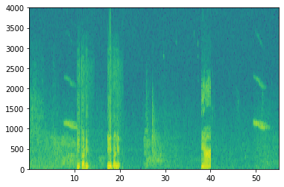
Data Synthesis
y⟨t⟩ represent whether or not someone has just finished saying "activate."
Positive words (‘italy’)
Negative words (other words than ‘italy’)
Backgrounds
With this elements we will create the training audio clip (10 sec) for the train set and we will study the spectogram information.

Slide 5
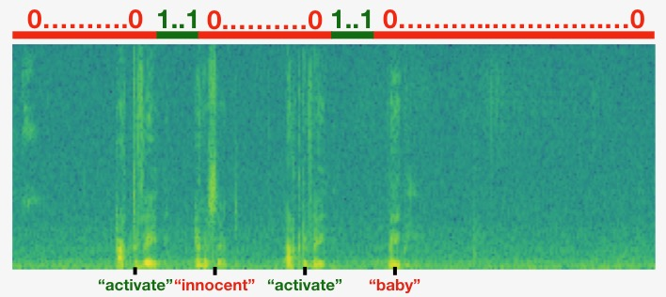
Data Synthesis
With this train will start the synthetized process.
It’s important because in this way it’s more simple the generation of y⟨t⟩ labels, that represent whether or not someone has just finished saying the hotword.
At beginning y⟨t⟩ will be = 0
After the add of “italy” we will update this parameter, so from the end of the word italy to the next 50 steps the target will be 1.
Hotword
Negative
Hotword
Negative

Slide 6
Data Synthesis
The key values for each audio clip are:
  441000 (raw audio)
  5511=Tx (spectrogram output, and dimension of input to the neural network) Are 0.0018 sec for each steps
  10000 (used by the pydub module to synthesize audio)
  1375=Ty (the number of steps in the output of the GRU). Are 0.0078 sec for each steps and our job is to predict for each of these intervals whether someone recently finished saying “Italy”

Slide 7
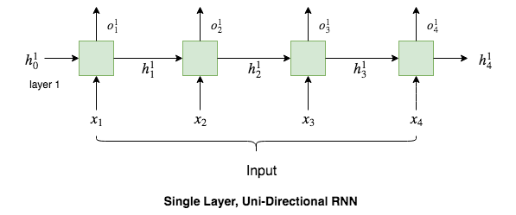
Model
Built the dataset it’s important to create a model that detect the trigger word.
The architecture of the model is based on a uni-directional RNN for the immediately detection of the Hotword.

Slide 8
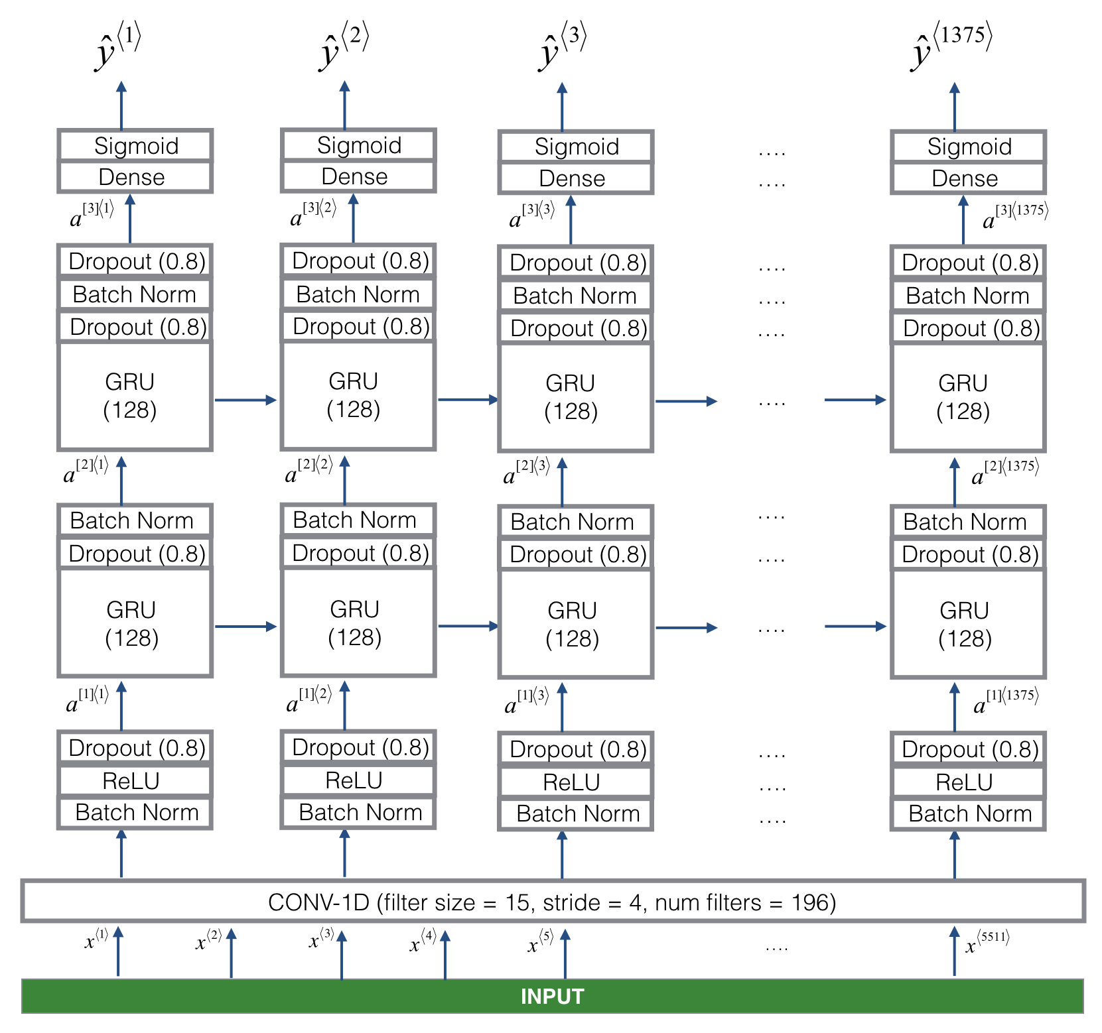
Model
Make a prediction for y⟨t⟩.
Read the sequence of inputs from left to right.
Extract low-level featurers and then generate an output of a smaller dimension, this layer help to speed up the model, because the GRU has to process 1375 timesteps.

Slide 9


